Slide 1
HUMANITIES AND SOCIAL SCIENCES INTER-CLUB COUNCIL
FALL 2021
Notes:
Jazmin

Slide 2
ZOOM NETIQUETTE AND INTRODUCTIONS
Mute Mic when not speaking
Keep cameras on whenever possible
Rename yourself to include your org, name, and pronouns
Board members will make sure to maintain pronouns
Intro: When called on please state your name, major, year, what club you represent and something you are passionate about.
Notes:
Jazmin

Slide 3
ICEBREAKER
In your various breakout rooms, go to your photos/gallery and show the others your favorite photo and tell the story behind the photo. 10 minutes!
Be sure to introduce yourself:
Name
Pronouns
Major
Club you are affiliated
Breakout room of 3-5 people
Notes:
Julieta

Slide 4
WHY DO WE EXIST?
To distribute funds from ASI for student travel and on-campus events open to all students
Increase inter-relation and collaboration between H&SS organizations and foster a more well-rounded learning environment
Promote our college and showcase our work and achievements as students
Notes:
Jazmin

Slide 5
LEADER’S CONTACT INFO
Jazmin Flores, Chair
asi.hss.icc@gmail.com
Student Hours: Tuesday (9-10:30 am)Wednesday (8-9:30 am)
Location(s): zoom: 666 190 0019 and Gordon Hall 211B
Julieta Zavala, Vice Chair / Treasurer
hss.icc.vicechair@gmail.com
Student Hours: Monday (9 - 11 am)
Location(s): zoom: 83815925374// passcode: 128372
Leah Yagin, Director of Administration
doa.hss.icc@gmail.com
Student Hours: Monday (9am-11am)
Location(s): Zoom: 409 806 1817
Passcode: m6b7Df
N/A, Social Justice Facilitator
sjf.hss.icc@gmail.com
Student Hours: n/a
Location(s): n/a
Notes:
Jazmin

Slide 6
LEADER’S CONTACT INFO
N/A Director of Public Relations
hss.icc.pr@gmail.com
Student Hours: n/a
David Velazquez, Board of Director of HSS
asboard-hss2@fullerton.edu
Student Hours: by appointment
Marcus Arnline, Board of Director of HSS asboard-hss@fullerton.edu
Student Hours: by appointment
Notes:
Jazmin

Slide 7
ADVISING
Dr. Connie Moreno Yamashiro, Advisor and Assistant Dean of Student Affairs
camoreno@fullerton.edu
Kayla Cortez, Graduate Assistant
zz-kacortez@fullerton.edu
Notes:
Jazmin

Slide 8
SUBMITTING PROPOSALS & CHECKLISTS
8074: Contracts Fees & Rentals
8077: Travel (will look different Fall 2020)
Notes:
Julieta

Slide 9
CHECKLISTS
8074 Checklist
8077 Checklist
Find updated checklists under "Financial Proposal Forms and Documents" through:
http://hss.fullerton.edu/students/icc/interclub_council.aspx
Notes:
Julieta

Slide 10
Changes in the Checklist
Allocation form will be changed to an online form by September 30, 2021
For now we will continue to use the allocation form that is on the HSS ICC website
http://hss.fullerton.edu/students/icc/interclub_council.aspx
Notes:
Julieta

Slide 11
WHO DO I SUBMIT MY PROPOSAL PACKET TO?
Email electronic packet to Chair, Vice Chair/Treasurer, and DOA by 10:00am on the Monday before you propose as one PDF document.
No physical packet due, only electronic packet required for fall 2021
Notes:
Julieta

Slide 12
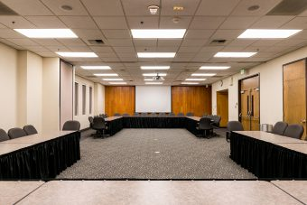
ROBERT'S RULES OF ORDER
Notes:
CMY

Slide 13
ROBERT'S RULES OF ORDER Overview
HSS ICC is a Funding Council
Specific language is used for Robert’s Rule of Order
Chair (Jazmin) will facilitate the meeting and use Robert’s Rules of Order
You as HSS ICC Representatives will also use specific language in the meeting to uphold Robert's Rules of Order
Why HSS ICC Bylaws
HSS ICC ByLaws_Updated Spring 2020.docx
Example on Section Article IV, Section 5
Order in which we will have our meetings
Notes:
CMY

Slide 14
ROBERTS RULE'S VIDEO
https://www.youtube.com/watch?v=eYwKX_P8YkU&feature=emb_title
Main Motion
Amendment
Amendment to an Amendment
Feel free to re-watch the full video! Or contact any of the e-board members for questions**
Notes:
CMY

Slide 15
ROBERT'S RULES IN BYLAWS
Expectations
That you follow Robert’s Rule of Order when:
Approving Agenda and Minutes
Roll Call
Opening items from Old Business and New Business
During Discussion, Questions, and Voting of Proposal Packets
Making Announcements
Roberts Rule of Order Cheat Sheet (1).docx review
What does Robert's Rules Look Like for our meetings?
Notes:
CMY

Slide 16
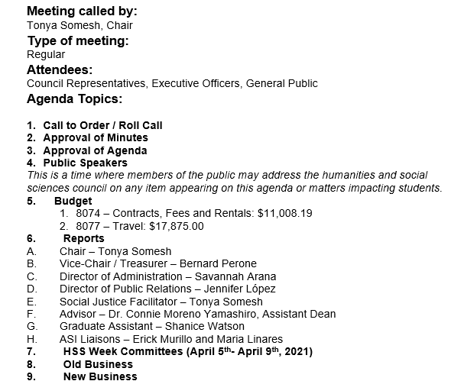
Past Agenda Example

Slide 17
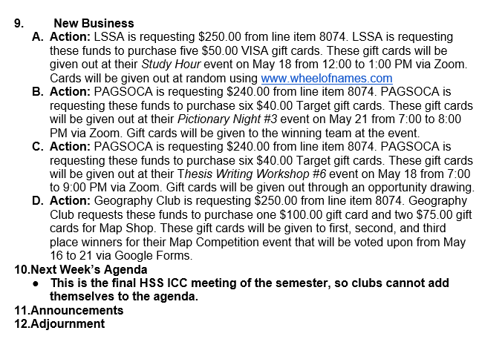
Past Agenda Example

Slide 18
ROBERT'S RULES VIRTUAL PRACTICE
Making a Main Motion Exercise
Robert's Rules Motion document (1).docx
Notes:
CMY

Slide 19
Thank you! Questions?
Notes:
CMY

Slide 20
RETURNING ORGANIZATIONS
Registered through Student Life and Leadership
Fill out the HSS ICC online registration form
Complete a packet including:
Letter from the advisor and department chair (On CSUF letterhead) – one letter is ok with both signatures (digital signature are ok)
Copy of class schedule with students CWID and CSUF email for each representative
A roster showing 75% of club members are from the College of Humanities & Social Sciences, OR a letter of support from the advisor and department chair confirming that at least 75% of club members are H&SS students.
FOR NEW ORGANIZATIONS
Complete steps listed above
Write up a brief ½ - 1-page explanation as to why you would like to sit on the council and how you will contribute to the value of Humanities and social sciences (This will later be presented to the council, and new memberships will be voted on)
Notes:
Leah
Have HSS ICC Council Registration Checklist ready

Slide 21
WHAT NEEDS TO BE INCLUDED IN THE LETTER OF SUPPORT?
Must be on OFFICIAL CSUF LETTERHEAD
Student’s name ( Letter may include all names of HSS ICC representatives in the same letter)
Student organization name
Student’s CWID
Student enrollment status (full or part time), majoring in Humanities and Social Sciences
Student is in good academic standing
(Recommended) to say that student is supported by the Faculty advisor and Department chair in their ability to accurately represent the student body
Advisor letter template can be found on HSS ICC website
Notes:
Leah

Slide 22
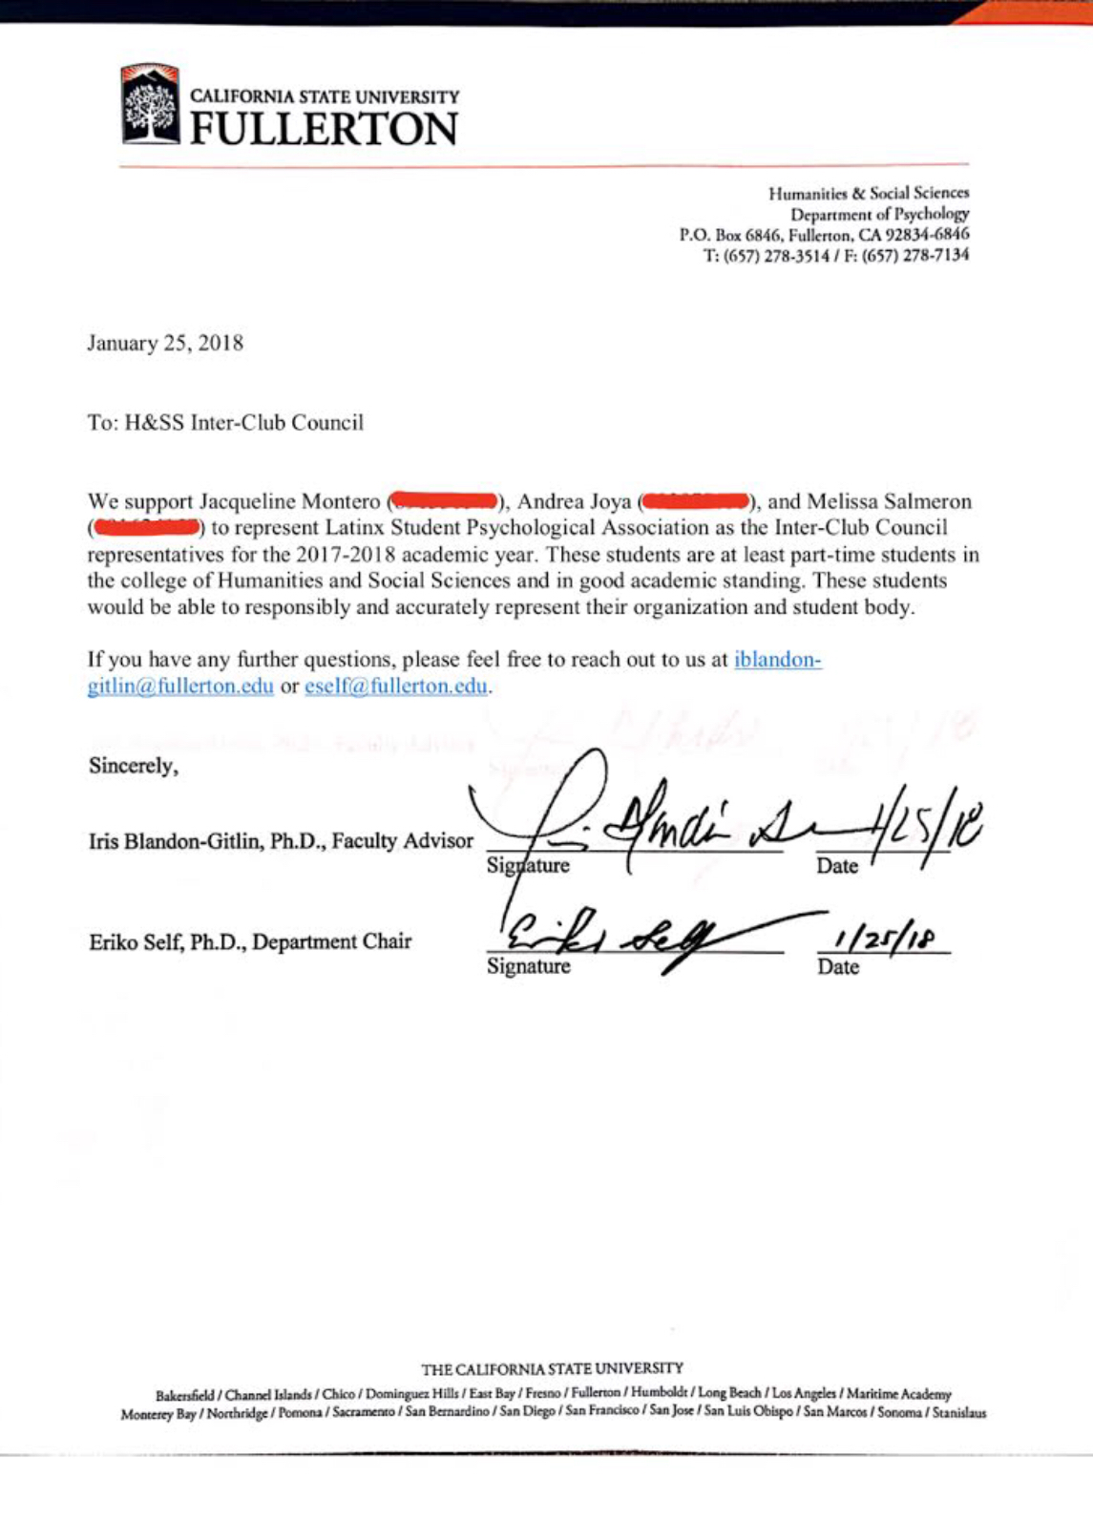
Official Letterhead Sample
Notes:
Leah

Slide 23
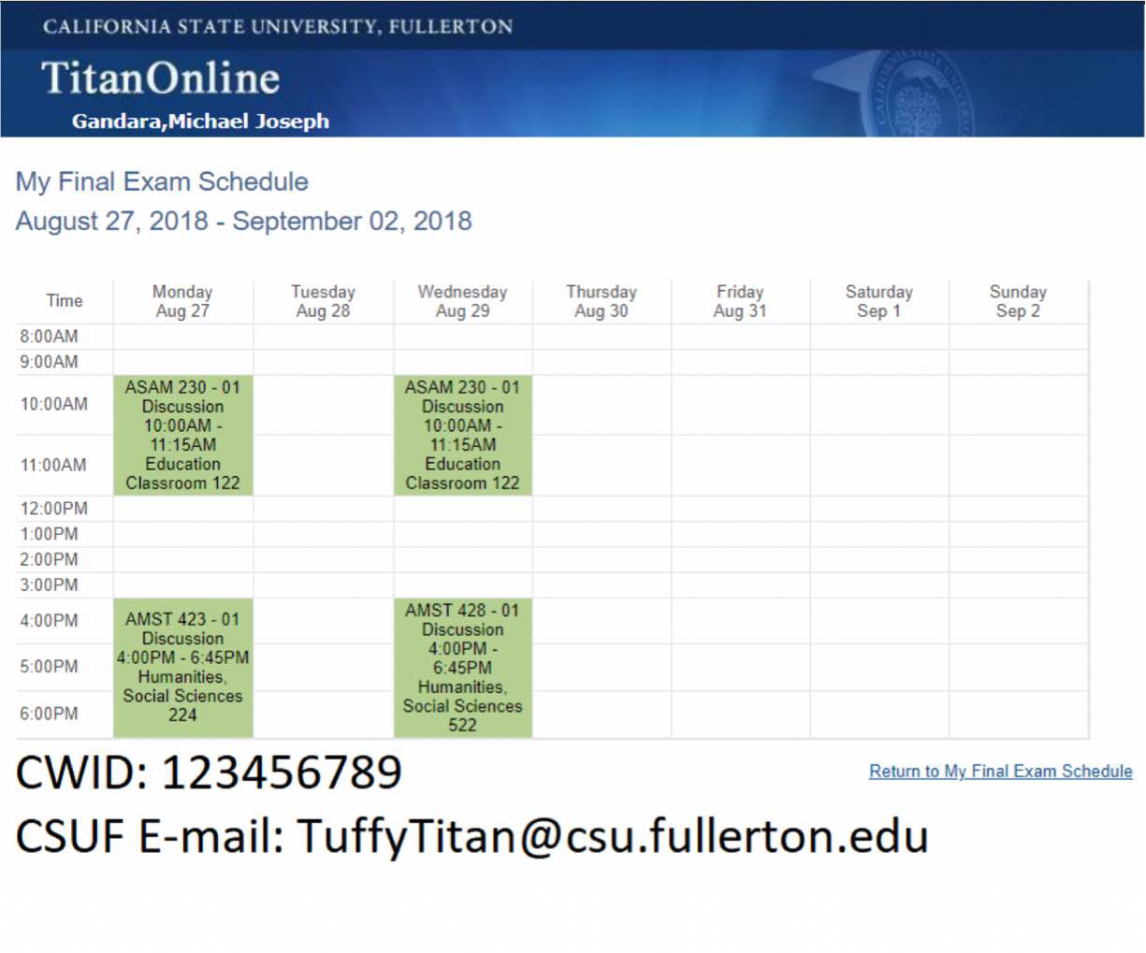
SAMPLE SCHDEULE
Notes:
Leah

Slide 24
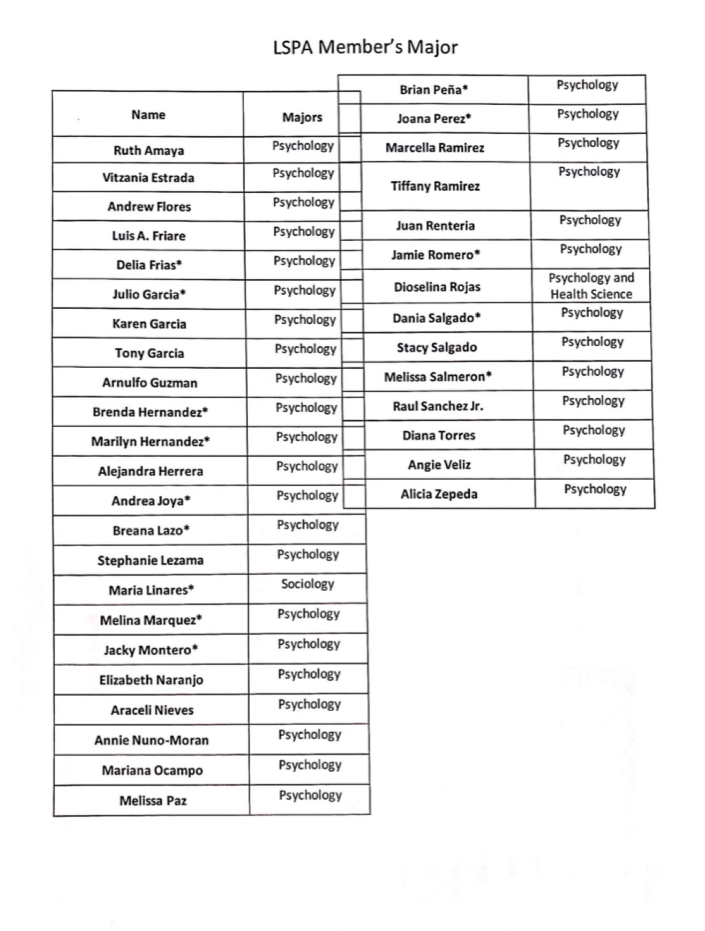
ROSTER SAMPLE
99% HSS majors
Notes:
Leah

Slide 25
REMINDERS
Vacant Positions in Social Justice Facilitator and Director of Public Relations
GroupMe Discussion (create new one or add folks to last year’s GroupMe page)
Who would like to be apart of next week’s agenda?
Re-registration packet due Thursday, Sep 2 by 11: 59 pm for HSS ICC
Re-registration through Student Life and Leadership Office using Titanlink due August 31st
To be apart of next week’s agenda send packet by Monday, Aug 30 by 10:00am
Any club announcements?
We’ll see you at Discoverfest!
Notes:
Jazmin

Slide 26
ANY QUESTIONS?

