Slide 1
HUMANITIES AND SOCIAL SCIENCES INTER-CLUB COUNCIL
Fall 2019

Slide 2
WHY DO WE EXIST?
To distribute funds from ASI for student travel and on-campus events open to all students
Increase inter-relation and collaboration between H&SS organizations and foster a more well-rounded learning environment
Promote our college and showcase our work and achievements as students

Slide 3
LEADERSHIP
Jacqueline Montero, Chair
asi.hss.icc@gmail.com
Office Hours by appointment
Ginny Oshiro, Vice Chair / Treasurer
hss.icc.vicechair@gmail.com
Office Hours by appointment
Gabriella Cuna, Director of Administration
doa.hss.icc@gmail.com
Office Hours by appointment
Valarie Segovia, Social Justice Facilitator
sjf.hss.icc@gmail.com
Office Hours by appointment
Leslie Rodriguez, Director of Public Relations
Hss.icc.pr@gmail.com
Office Hours by appointment
Maria Linares, ASI Board of Directors, Vice Chair
asboardvicechair@gmail.com
Office Hours by appointment
Melanie Therrien, ASI Board of Directors
asboard-hss@fullerton.edu
Office Hours by Appointment

Slide 4
ADVISING
Dr. Connie Moreno-Yamashiro, Advisor and Assistant Dean of Students
camoreno@fullerton.edu
Miguel Quirarte, Graduate Assistant
zz-mquirarte@fullerton.edu

Slide 5
RETURNING ORGANIZATIONS
Registered through Student Life and Leadership
Fill out the online registration form
Complete a physical packet including:
Letter from the advisor and department chair (On CSUF letterhead)
Copy of class schedule with students CWID and CSUF email for each representative
A roster showing 50% of club members are from college Humanities & Social Sciences, or a letter of support from the advisor and department chair confirming that at least 50% of club members are H&SS students.
FOR NEW ORGANIZATIONS
Complete steps listed above
Write up a brief ½ - 1-page explanation as to why you would like to sit on the council and how you will contribute to the value of Humanities and social sciences (This will later be presented to the council, and new memberships will be voted on)

Slide 6
WHAT NEEDS TO BE INCLUDED IN THE LETTER OF SUPPORT?
Must be on OFFICIAL CSUF LETTERHEAD
Student’s name ( Letter may include all names in the same letter)
Student organization name
Student’s CWID
Student enrolled part-time status, majoring in Humanities and Social Sciences
Student is in good academic standing
(Recommended) to say that student is supported by the Faculty advisor and Department chair in their ability to accurately represent the student body

Slide 7
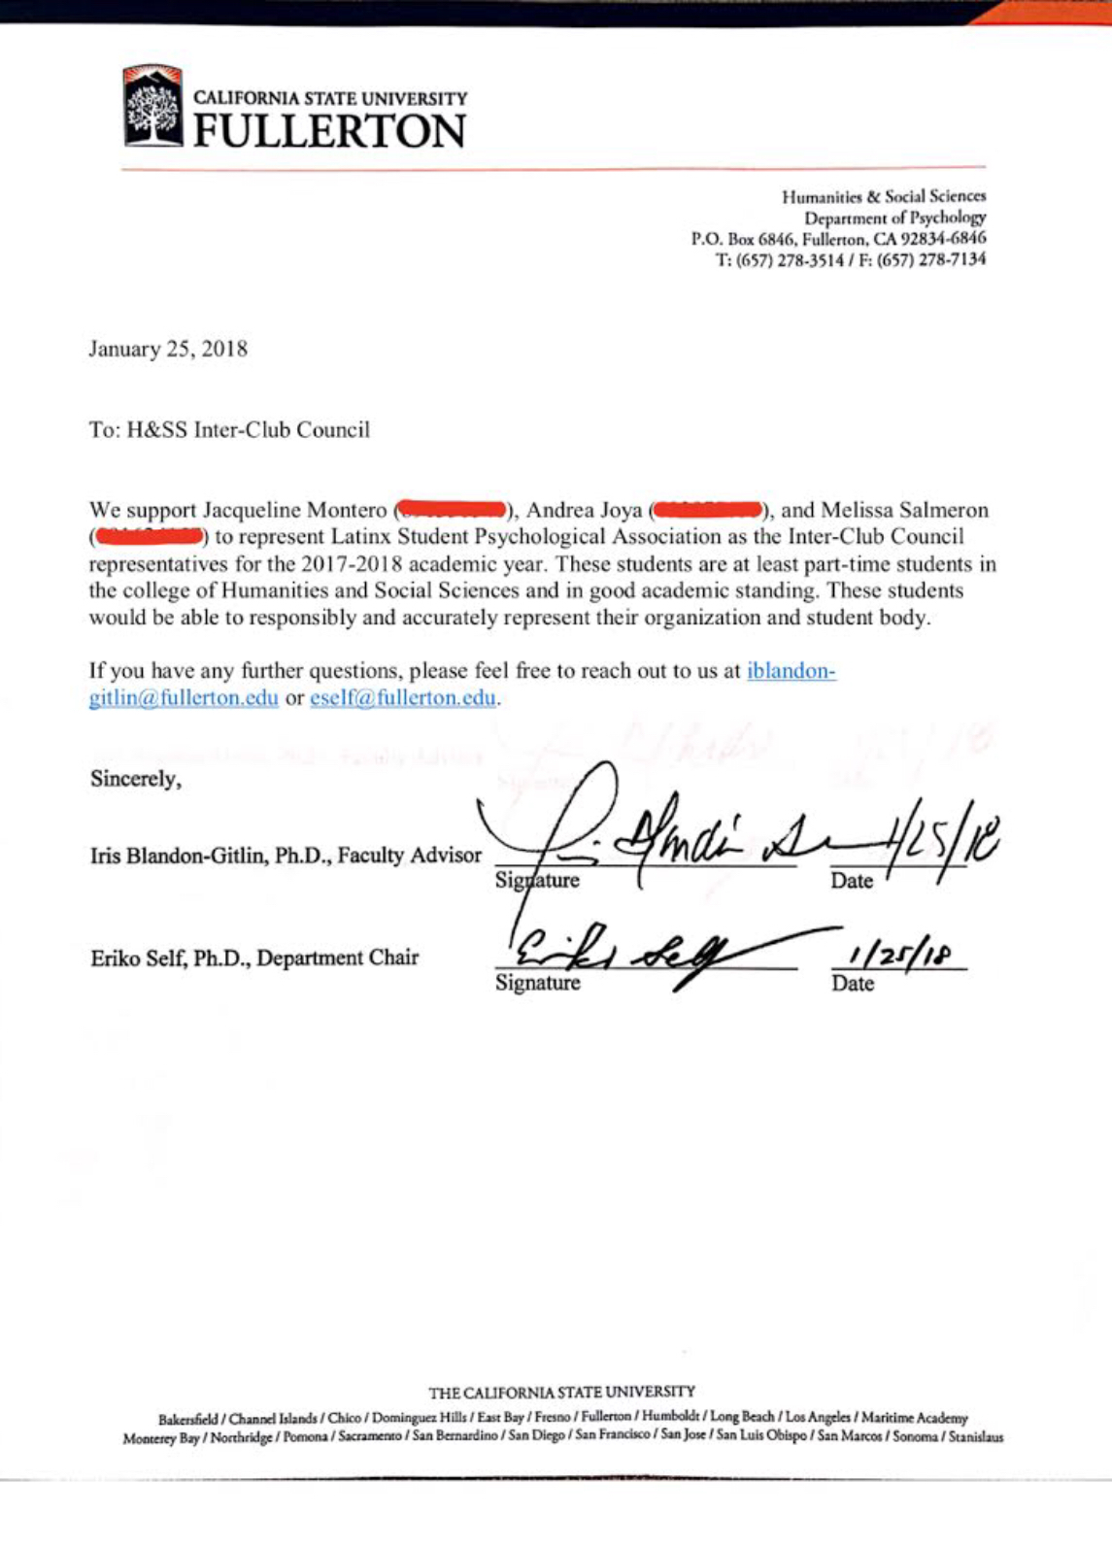
Official Letterhead Sample

Slide 8
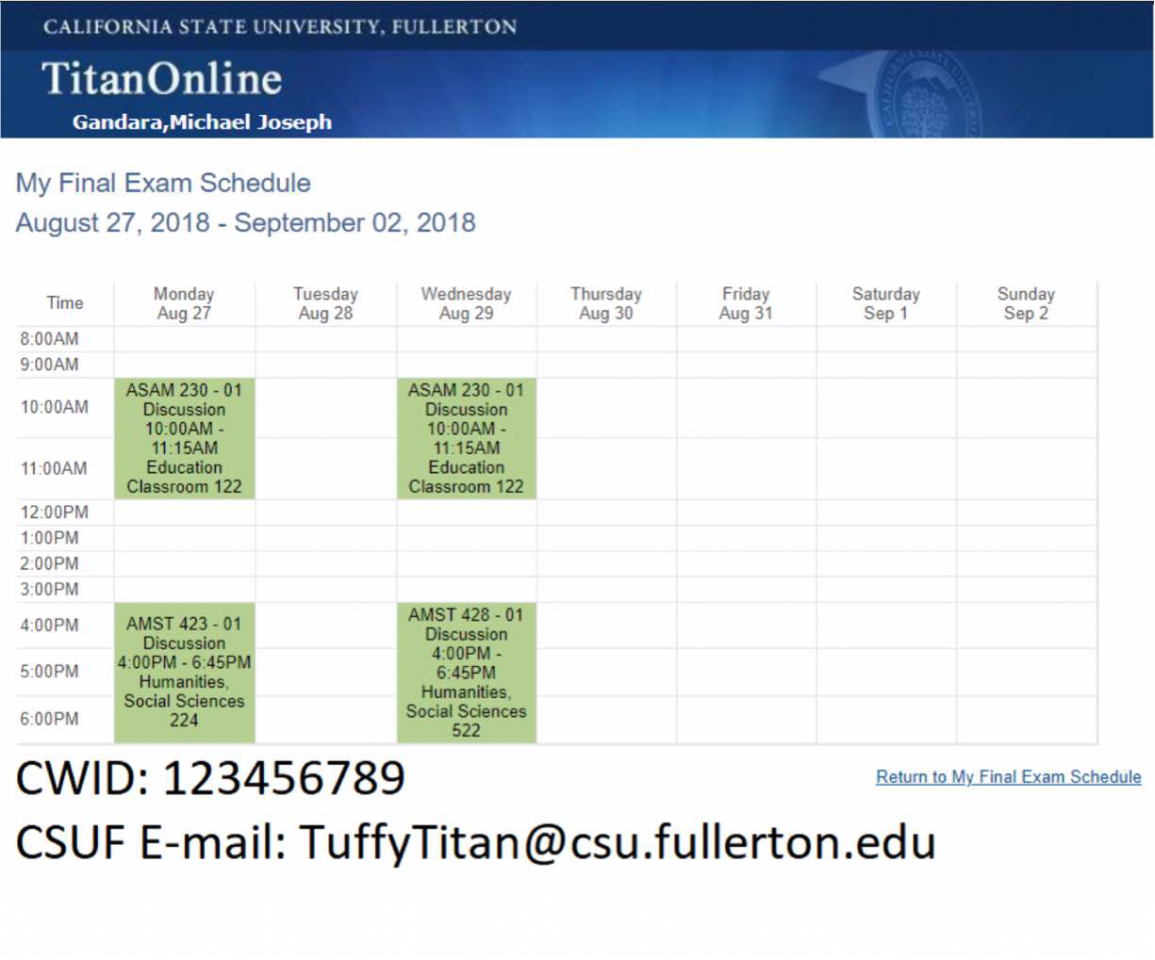
Sample Schdeule

Slide 9
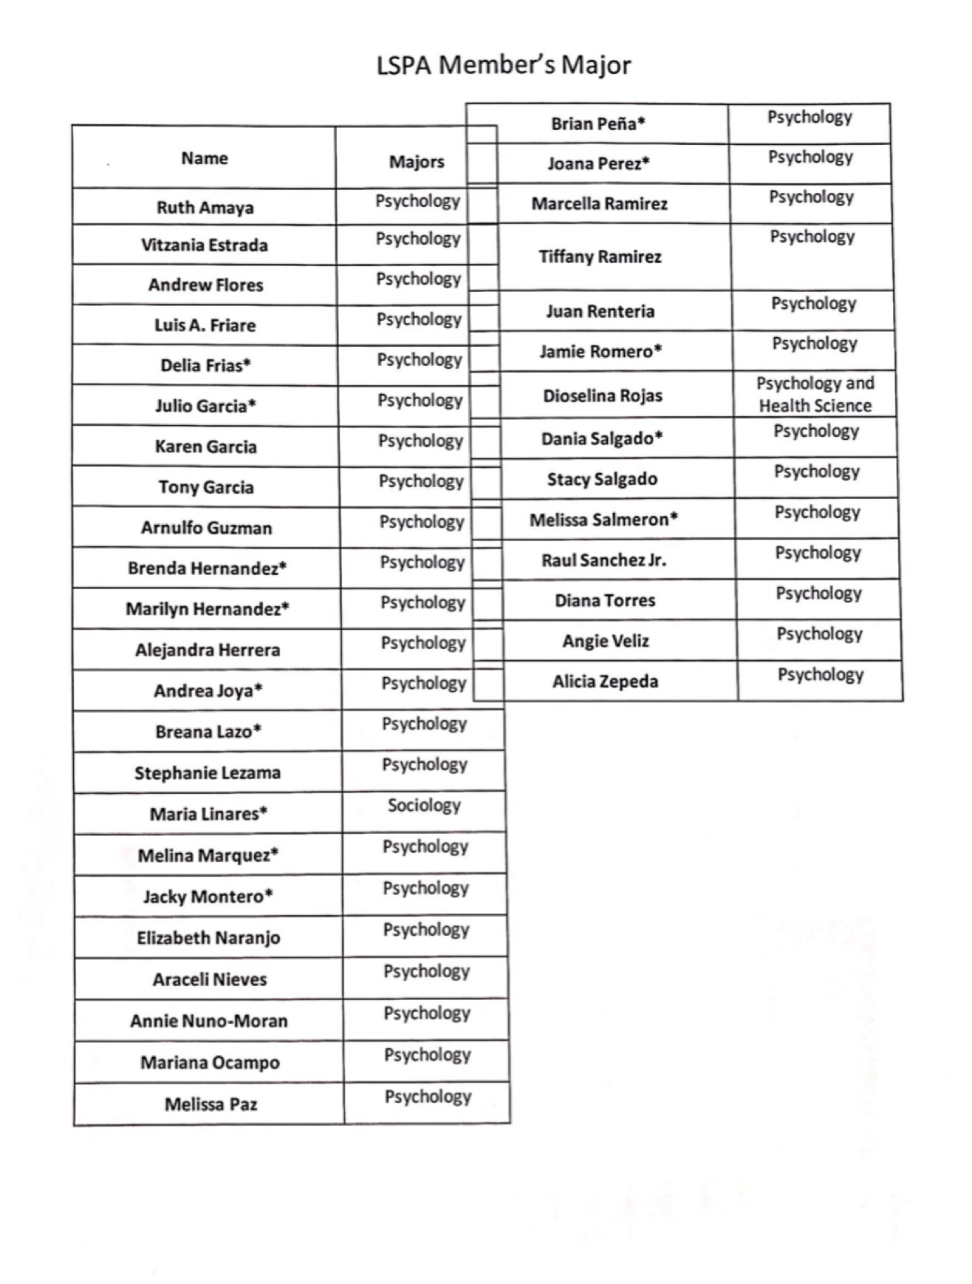
Roster Sample

